Slide 1
AXON Disclosure Portal - Receiving Digital Evidence from MCPO
August 2026

Slide 2
TABLE OF CONTENTS
Accessing Shared Evidence Slides 3-11
Customizing the Table Slides 12-13
Downloading Evidence Slide 14-16
Folders View Slides 17-28
Table View Slide 29

Slide 3
Accessing Shared Digital Evidence via Axon Justice
Once Paper Discovery is provided via the eDiscovery Portal, any available digital evidence will simultaneously be sent via Axon Justice. You will receive an email from Axon (noreply@evidence.com) notifying you that a case has been shared with you. Once you receive the email:
  Open the email and click on the provided link.
  You will be redirected to the Monmouth County Prosecutor’s Office Disclosure Portal.
  From the portal, you will be able to view and download each item of digital evidence that has been shared with you for 90 days from the date of this notice. After that time, access will expire and the files will no longer be available.
  Please ensure you download all evidence within 90 days, as access will expire after that period.
  Please note evidence may not be re-shared via Axon.
  File Size Warning: Some files may be large. Ensure you have adequate storage space before initiating downloads. If your computer does not have sufficient internal storage, we recommend using external storage devices such as hard drives or flash drives.
  Compressed File Warning: Some files may not extract using regular programs. A third-party program, like 7-Zip is used for compressing and decompressing files into various archive formats to save storage space and simplify file transfer. If the path name is too long, try clicking further into the compressed file as there are often zips within the zip, then extract the secondary zips. This method will shorten the file path and should allow the download.
If you experience technical difficulties accessing or downloading the files, please send an email with details of the issue to:
Email: axondiscovery@mcponj.org
Details of the issue:
Description of the problem: [briefly explain what happens — e.g., error message, file not loading, etc.]
Device and browser used: [e.g., Windows 11, Chrome browser]
Screenshot(s): [attach screenshots of any error messages]

Slide 4
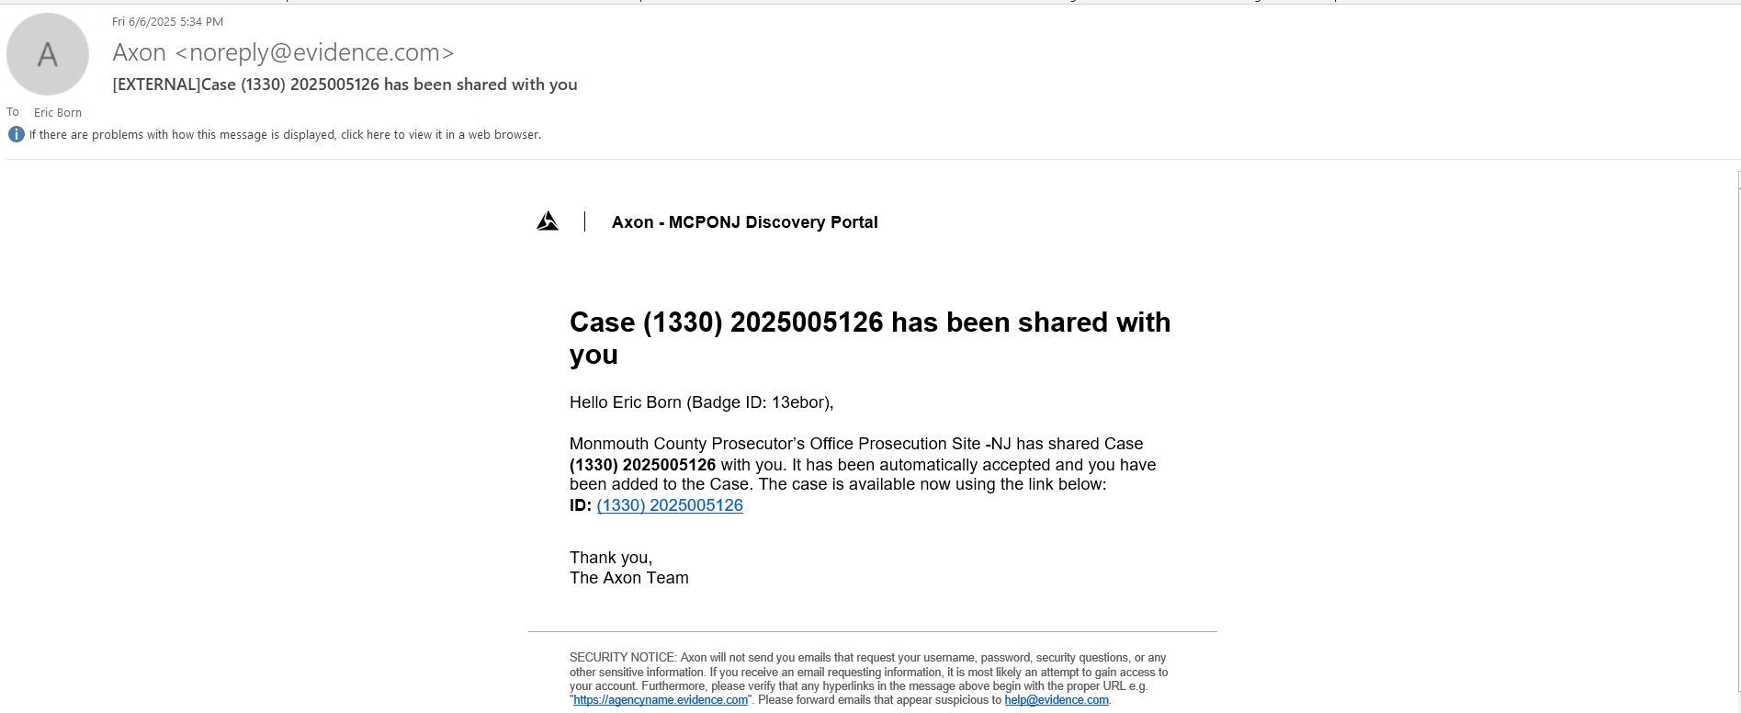
When there is media available for a particular case you will receive an e-mail from Axon. The below screen shot is what the e-mail will look like. Once you receive it, double click on the below link to open it.

Slide 5
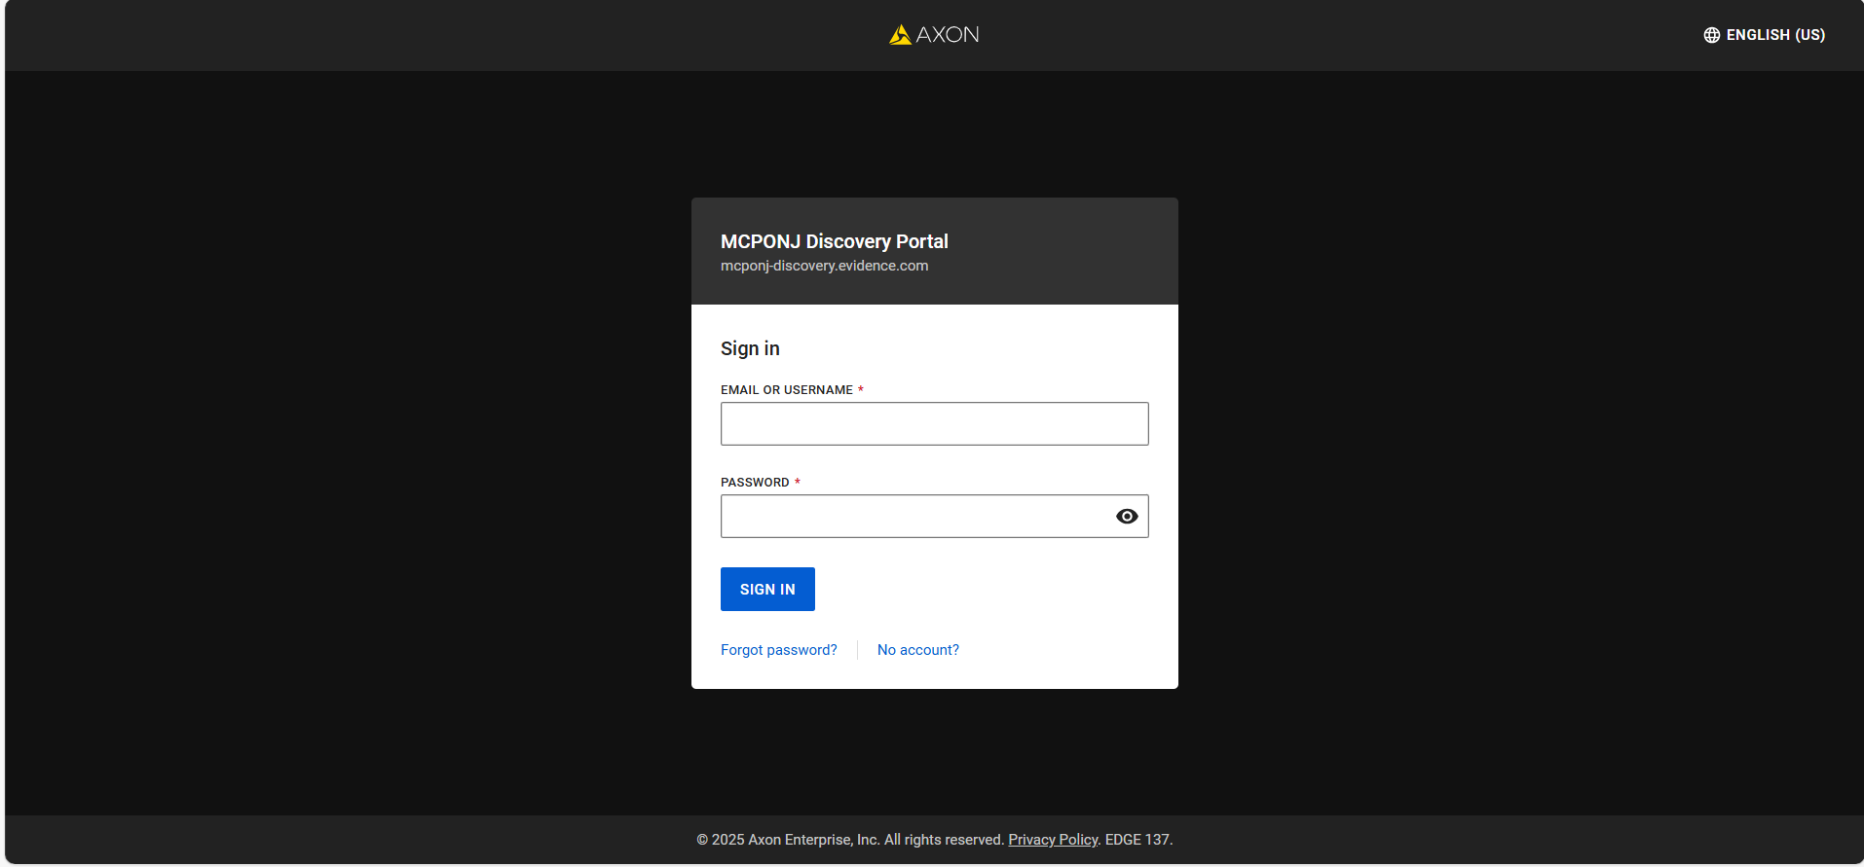
You will sign in using your e-mail address and password that is set-up for MCPONJ Discovery Portal.

Slide 6
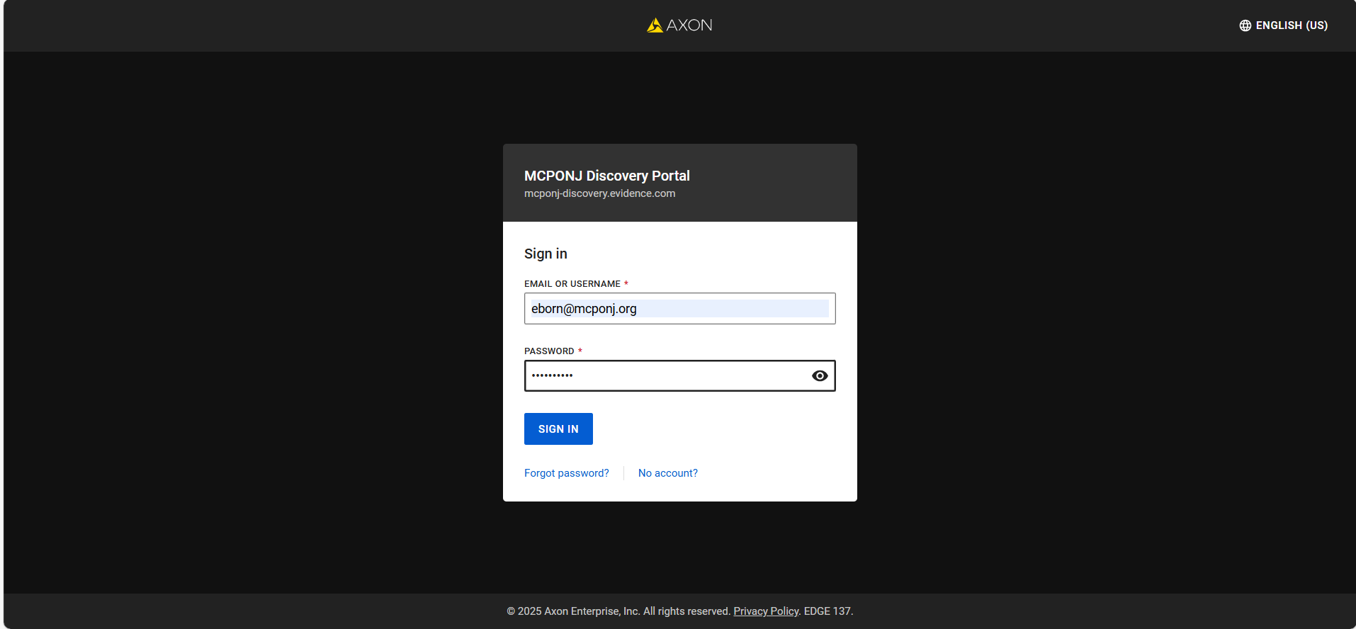
Click once on the ‘SIGN IN’ button.

Slide 7
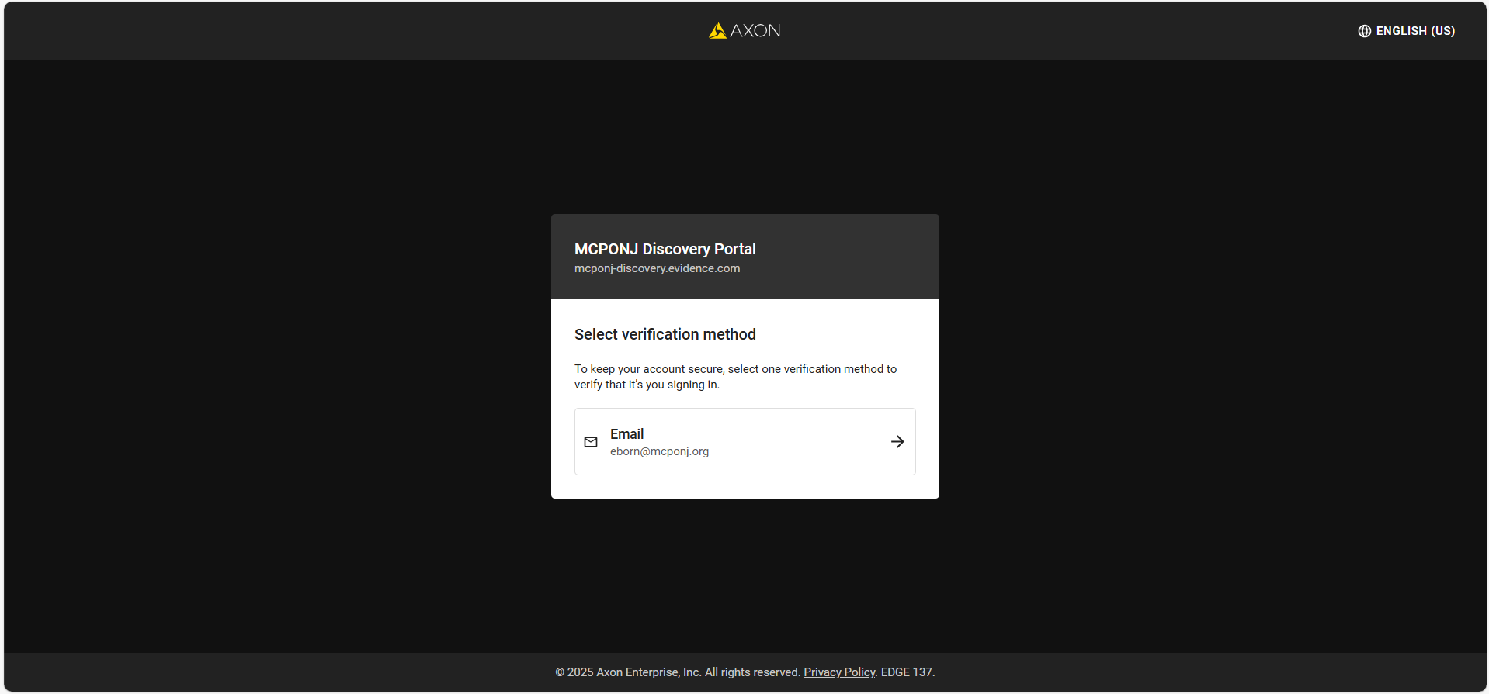
Click once on your e-mail address at the bottom of the screen to receive a verification code.

Slide 8
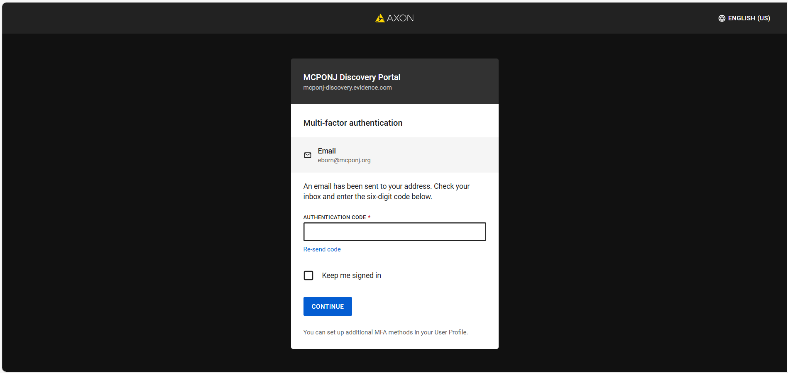
This is the next screen that appears. After a few minutes you will get another e-mail with that verification code. See next slide.

Slide 9
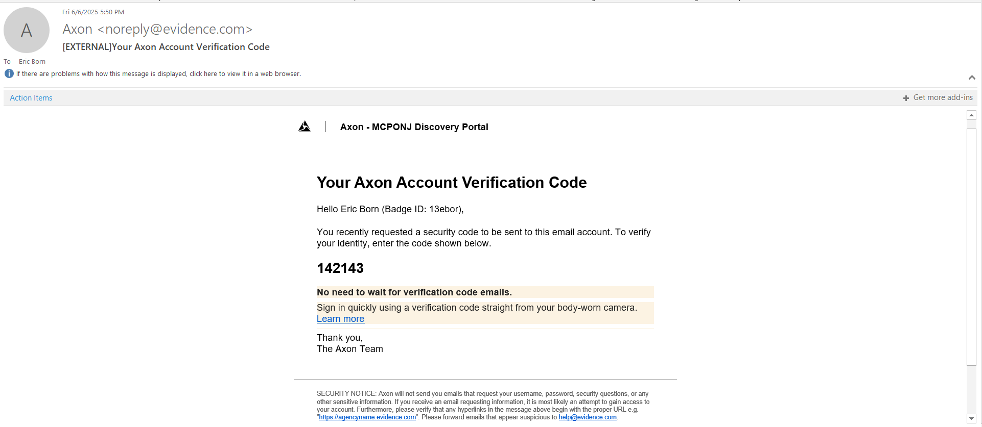
Below is the e-mail you will receive. Type the verification code on the next slide.

Slide 10
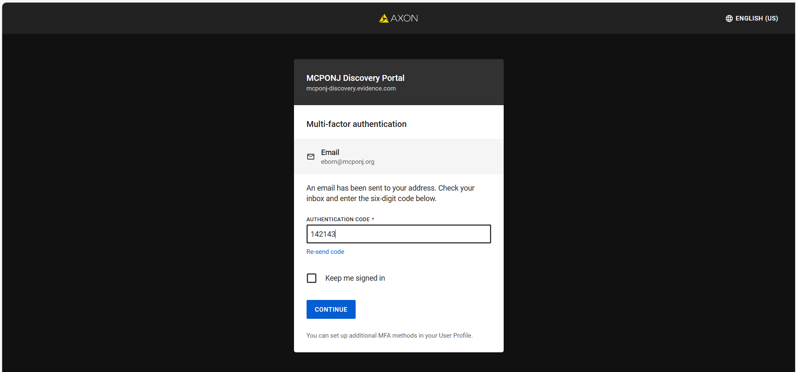
Click once on the ‘CONTINUE’ button.

Slide 11
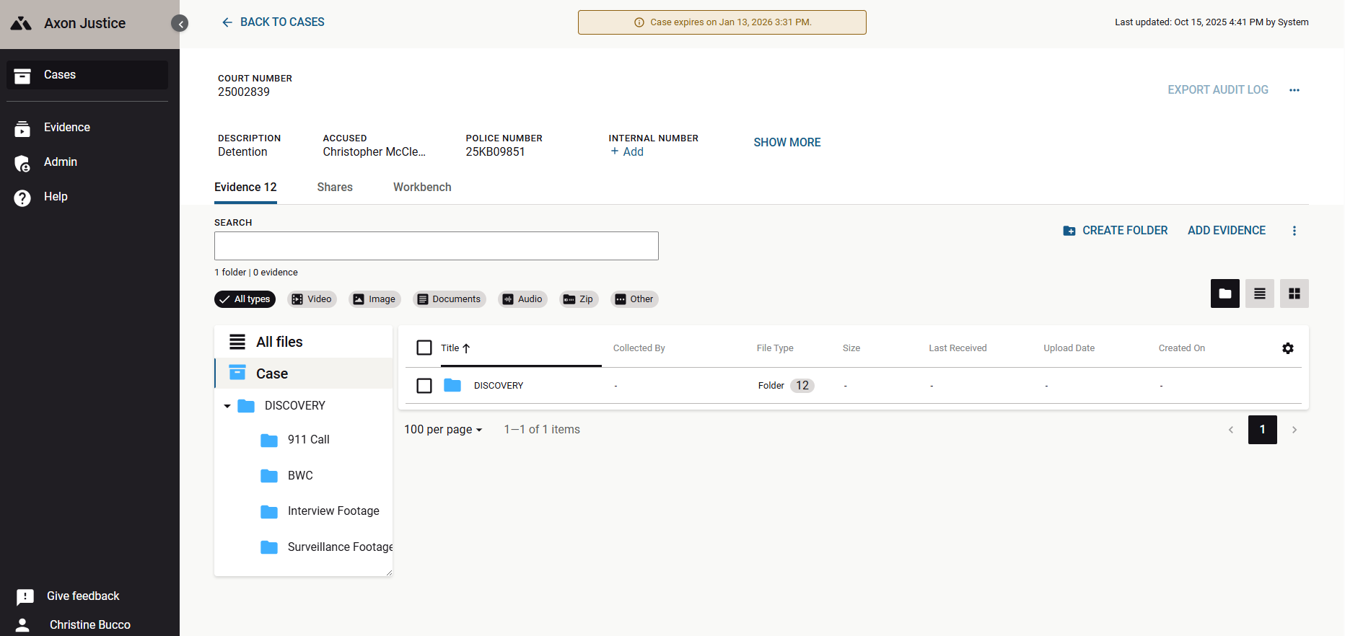
Once you type in the verification code you will be taken directly to the case you were notified about. Below is what your screen should look like.
Note: The link Expiration will appear. Evidence will need to be downloaded by the link expiration. Evidence may not be re-shared via Axon.
You will see from below it shows you how many pieces of evidence you received. You may view by Folder View (lists all Folders), Table View (lists all individual evidence) or Gallery View

Slide 12
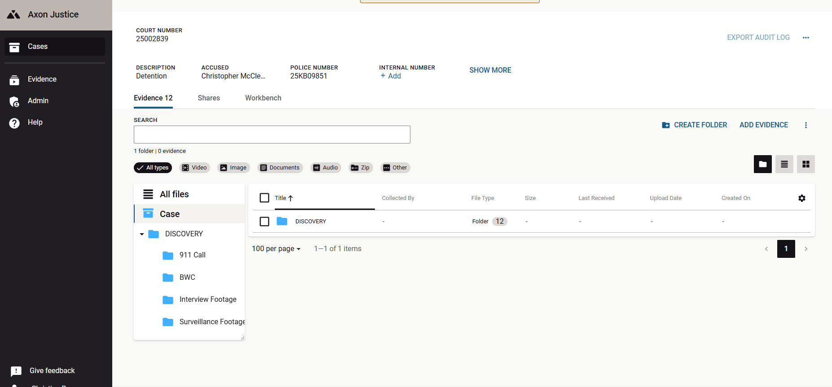
CUSTOMIZING THE COLUMN SETTINGS
Click the settings wheel (See next Slide)

Slide 13
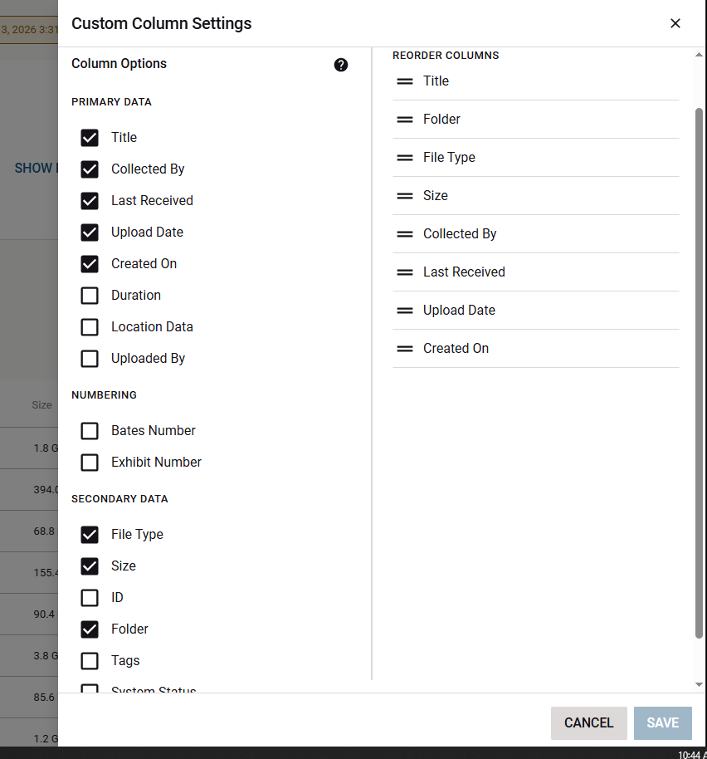
CUSTOMIZING THE COLUMN SETTINGS
You can select and deselect column options and reorder columns. It is suggested to enable the Folder and to reorder the folder after the title.

Slide 14
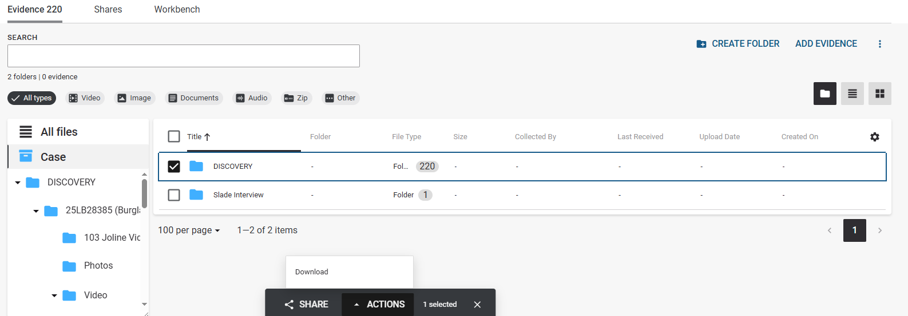
DOWNLOADING EVIDENCE
You may Download the entire Discovery Folder, Individual Subfolders or Individual Pieces of Evidence. To Download:
1. The Discovery Folder - in the folders view, select the Discovery package. The Actions Tab will then appear, select it and click download. Depending on the case of the case, the case download link may contain several .zip packages. The .zip packages will contain the folder structures. It is suggested to match up the downloads with the Discovery Portal for easier reference. NOTE: Evidence cannot be shared.
Individual Folders – Click into the Discovery Folder then select the folder or folders. The Actions Tab will then appear, select it and click download. NOTE: For larger cases, it is suggested to download individual folders, a few a time, for easier case management.
Individual Pieces of Evidence – See slides 17-23.

Slide 15
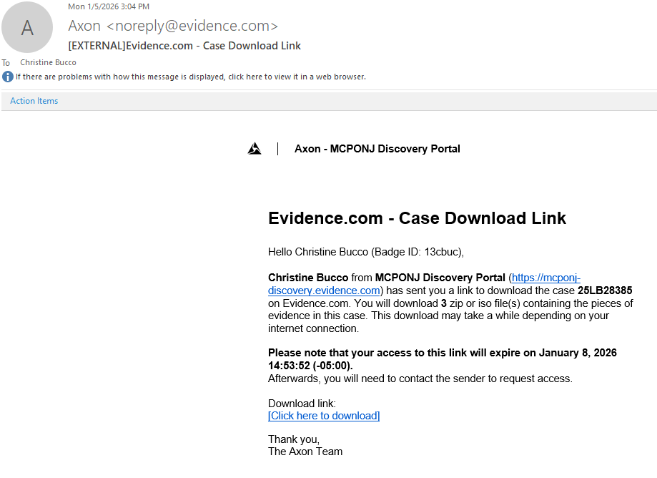
DOWNLOADING EVIDENCE
You will receive an email from Axon once the download is ready. Select the download link

Slide 16
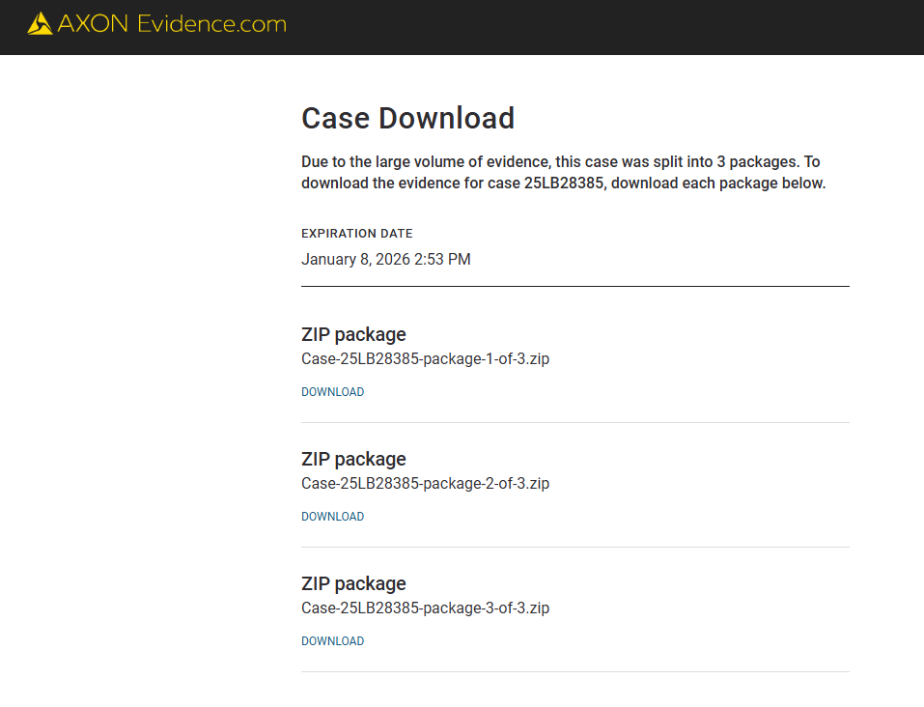
DOWNLOADING EVIDENCE
You will be redirected to Axon. This page will have a .zip package that will need to be downloaded.
Note: larger cases may be broken down into multipart downloads wherein multiple .zip packages will need to be downloaded.

Slide 17
FOLDERS VIEW
If evidence was organized into folders, the folders view will categorize the digital evidence further. You may click into a folder to see the digital evidence contained within. You may also click on the Discovery Folder to show how much evidence is within each subfolder (See next Slide)

Slide 18
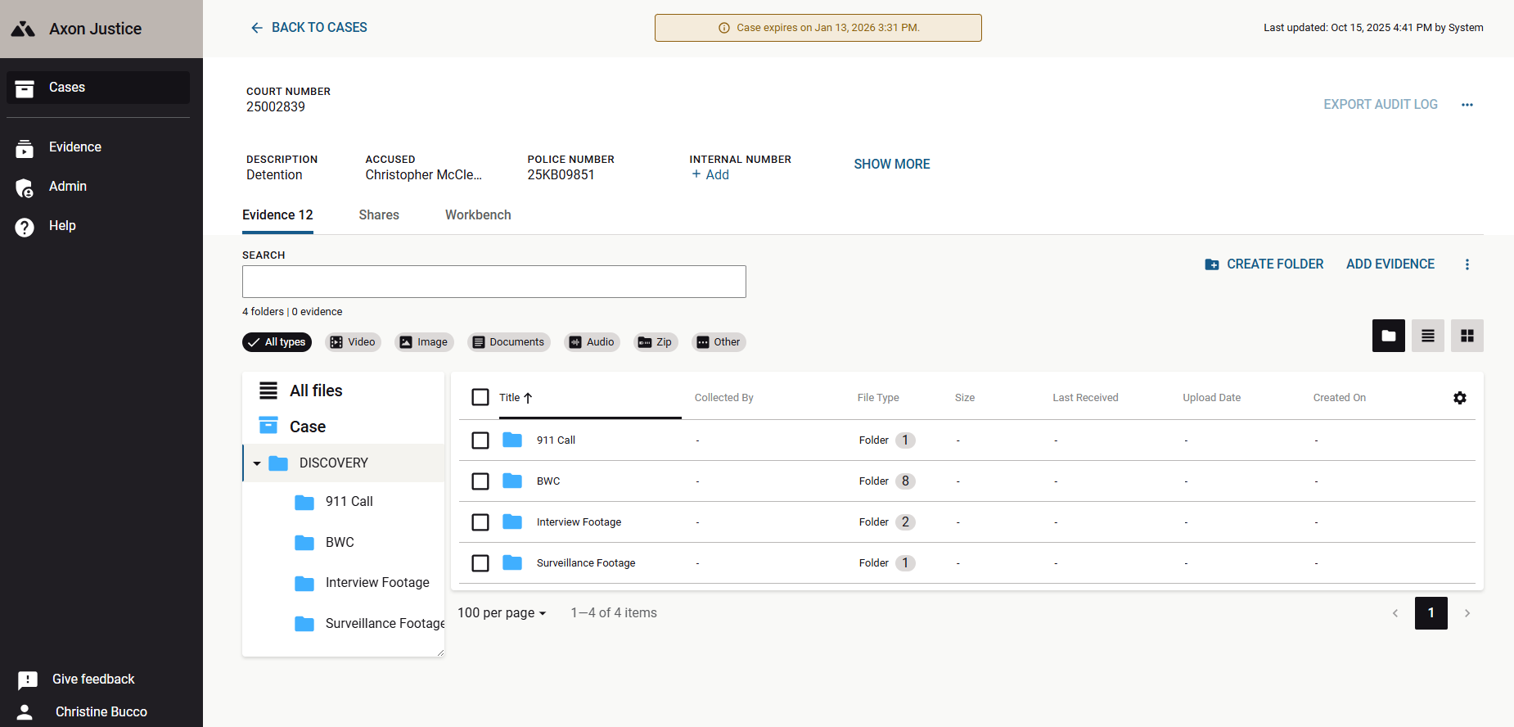
FOLDERS VIEW
As you can see the discovery has now been broken down to 4 folders; To view the videos within a folder click once on any folder.

Slide 19
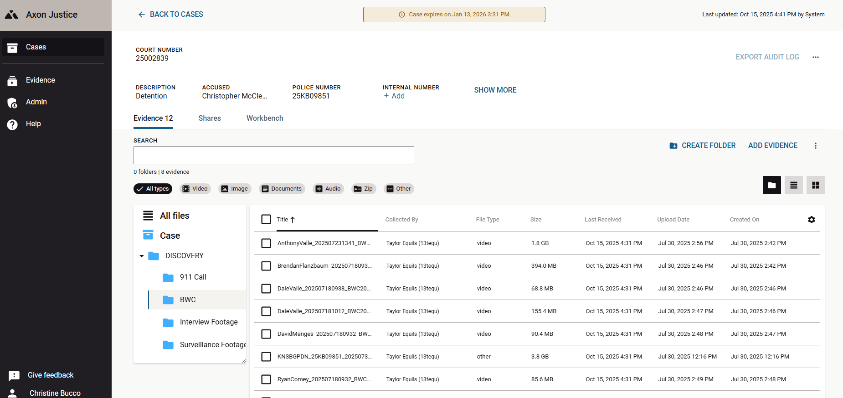
Next click on the first file that appears.

Slide 20
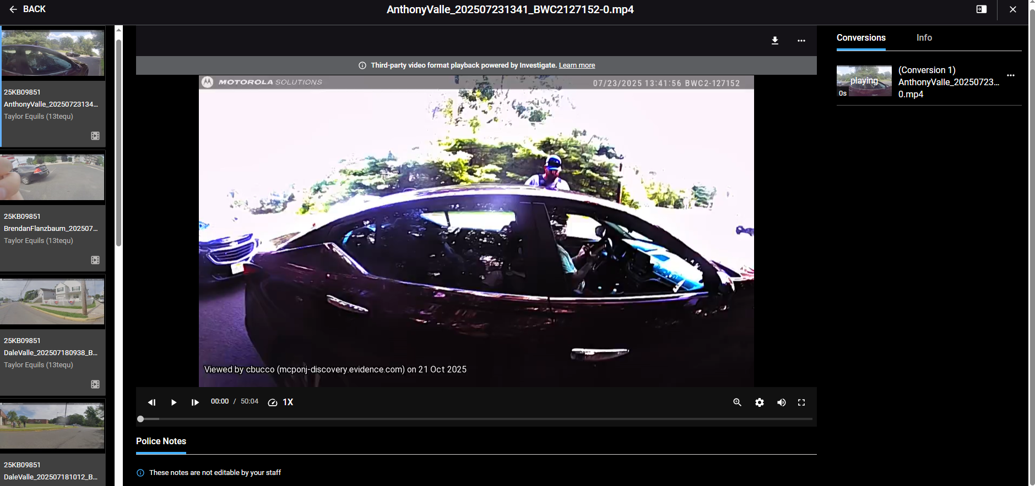
Next it brings you to the video you chose. From here you can take a quick view of the video by hitting the ‘Play’ button. You can also download the video to your desktop or file of your choice.

Slide 21
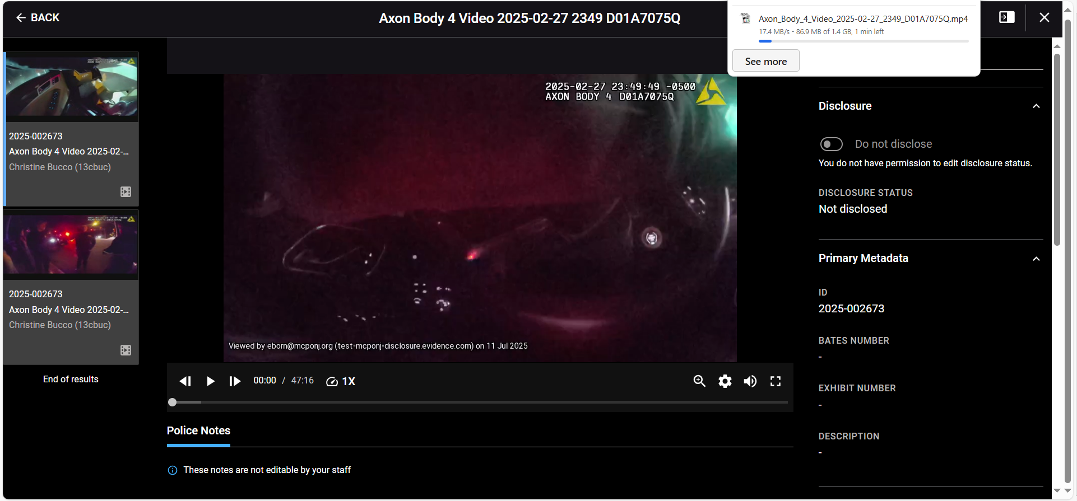
If you click on download, a dialog box will appear showing the progress of your download.

Slide 22
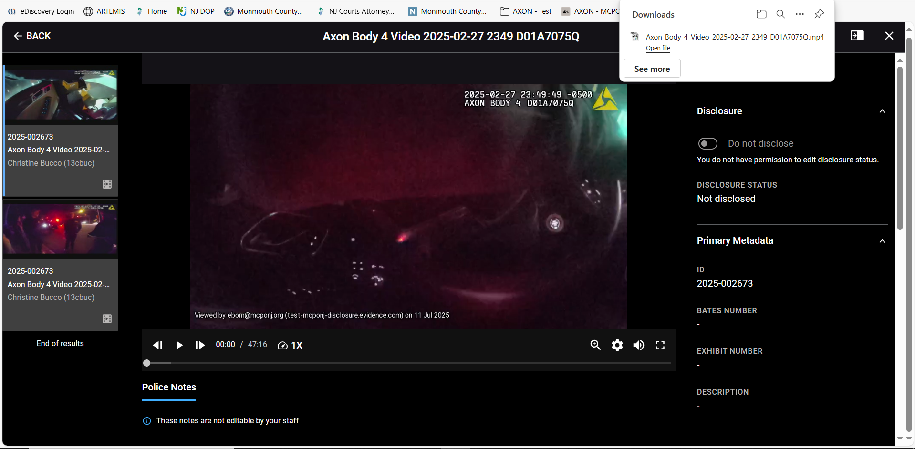
Once complete just click once on ‘Open file.’

Slide 23
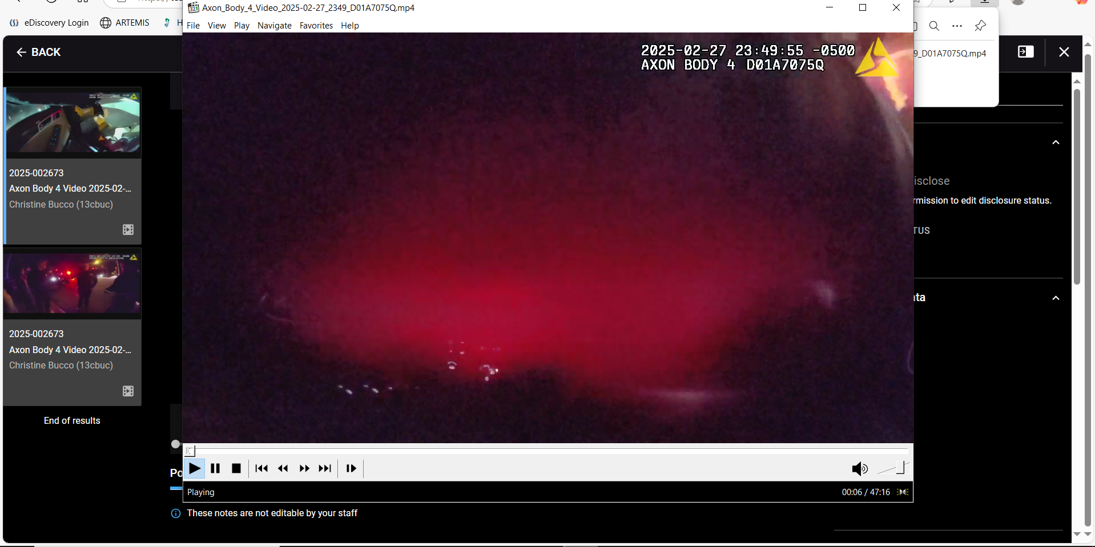
From here you click once on ‘File.’

Slide 24
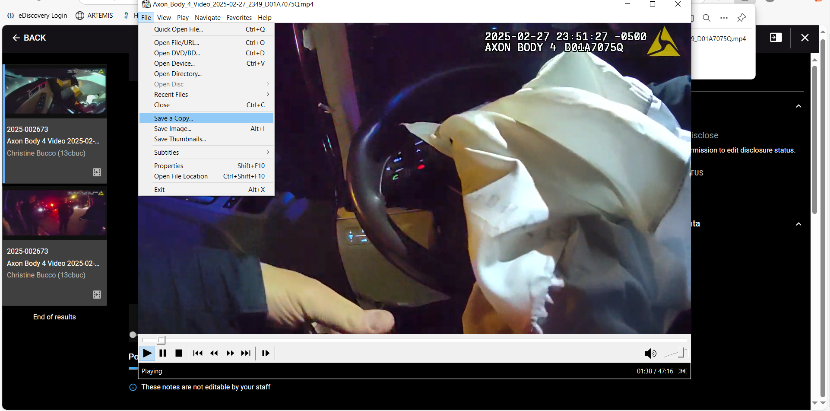
Click once on ‘Save a Copy….’

Slide 25
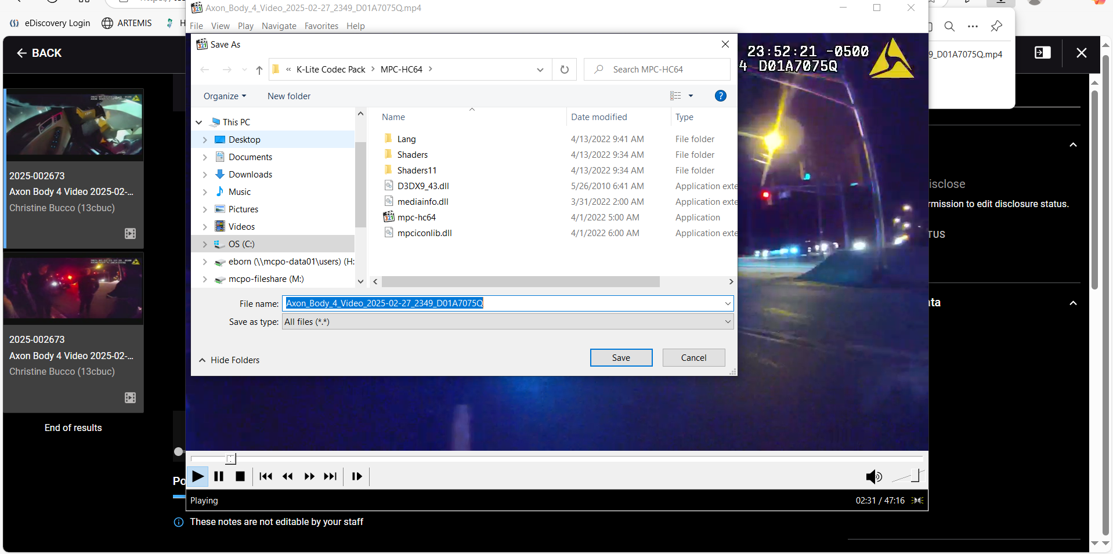
From here depending on your office set-up you can save the video anywhere you wish and then click once on the ‘Save’ button.

Slide 26
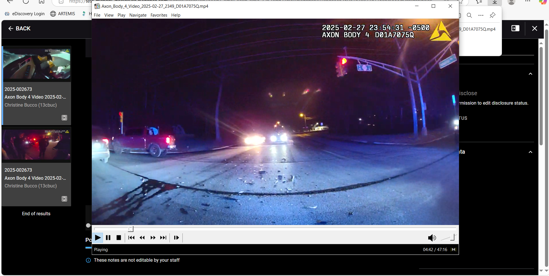
Once saved, click on the ‘X’ to close this video.

Slide 27
You are returned to ‘Axon’. If you have any other videos to review and download, they will be along the left side of the screen. If there is nothing else remaining you may click once on the ‘BACK’ button.

Slide 28
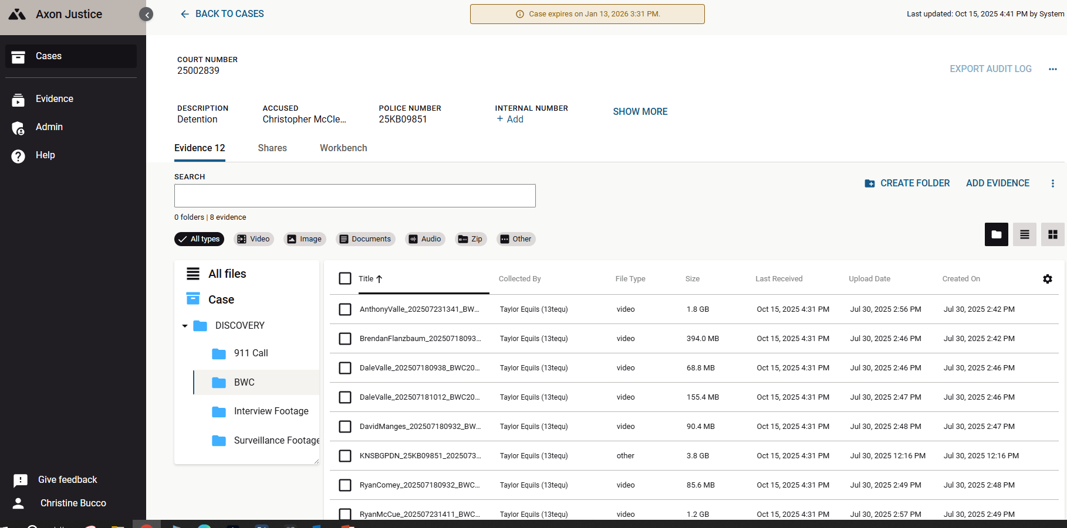
This brings you back to ‘Axon’ and you may click once on another folder to view evidence within that folder and follow slides 15-24.

Slide 29
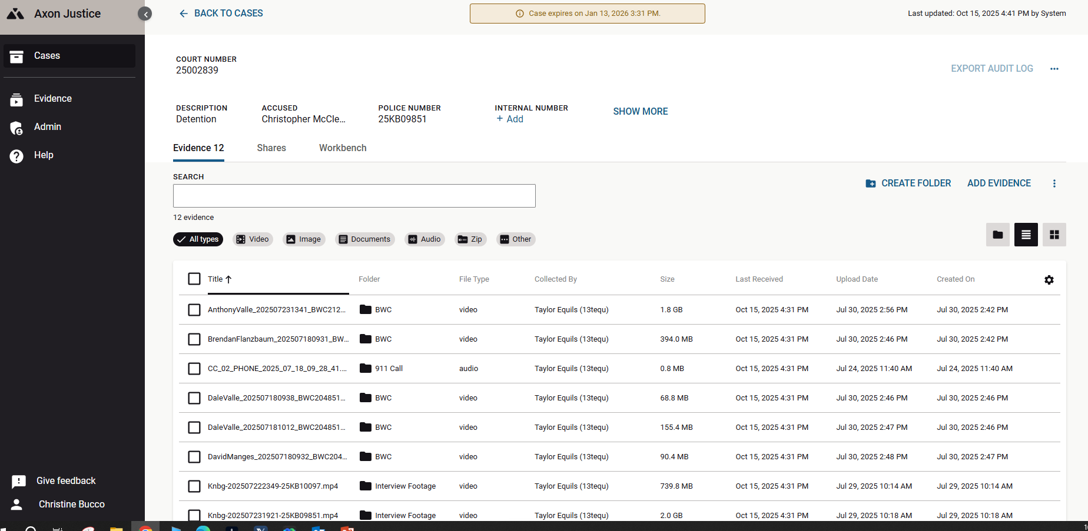
TABLE VIEW
This view lists all digital evidence available for the case. If the folder column was enabled (See slides 11-12 ), it will identify which folder each piece of evidence is in.
Click once on any evidence you wish to view and then follow slides 17-24.

